Slide 1

Practicum The bacterial genome and genetic variation by conjugation
Sofie Thijs, PhD
Vincent Stevens, PhD student
Leila Paquay, PhD student
23/10/2020

Slide 2
Practicum outline
Yesterday
1. gDNA and plasmid extraction
2. Inspect the gel results
3. Perform a bacterial conjugation: let a donor bacterium exchange genetic material with your bacterium
4. Evaluate the outcome of genetic exchange by plasmid extraction, agarose gel and fluorescence microscopy
5. Inspect gel results, closing discussion of the practicum and more information about the written report
Today
Today
Monday
Tuesday

Slide 3
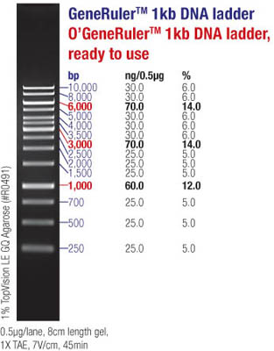

Slide 4
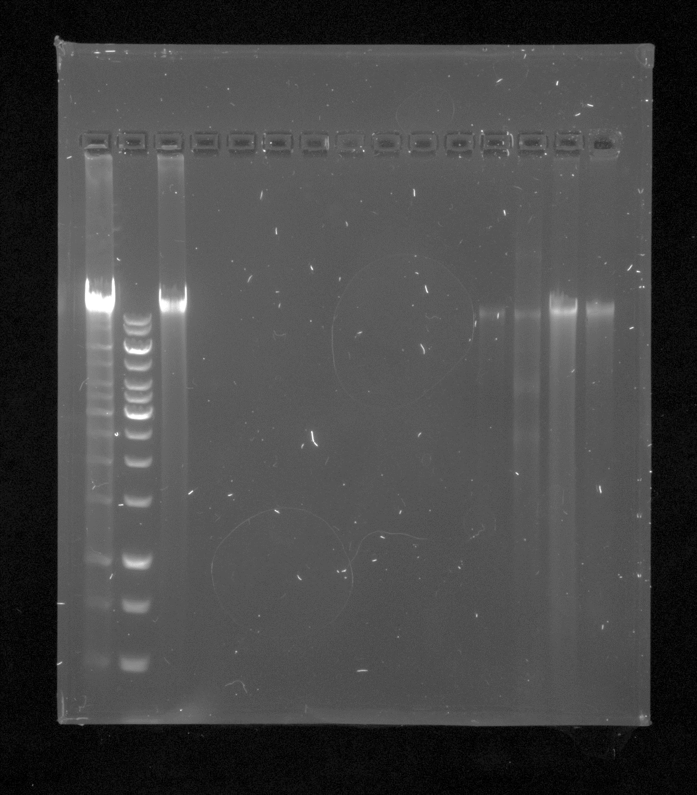
Gel 1

Slide 5
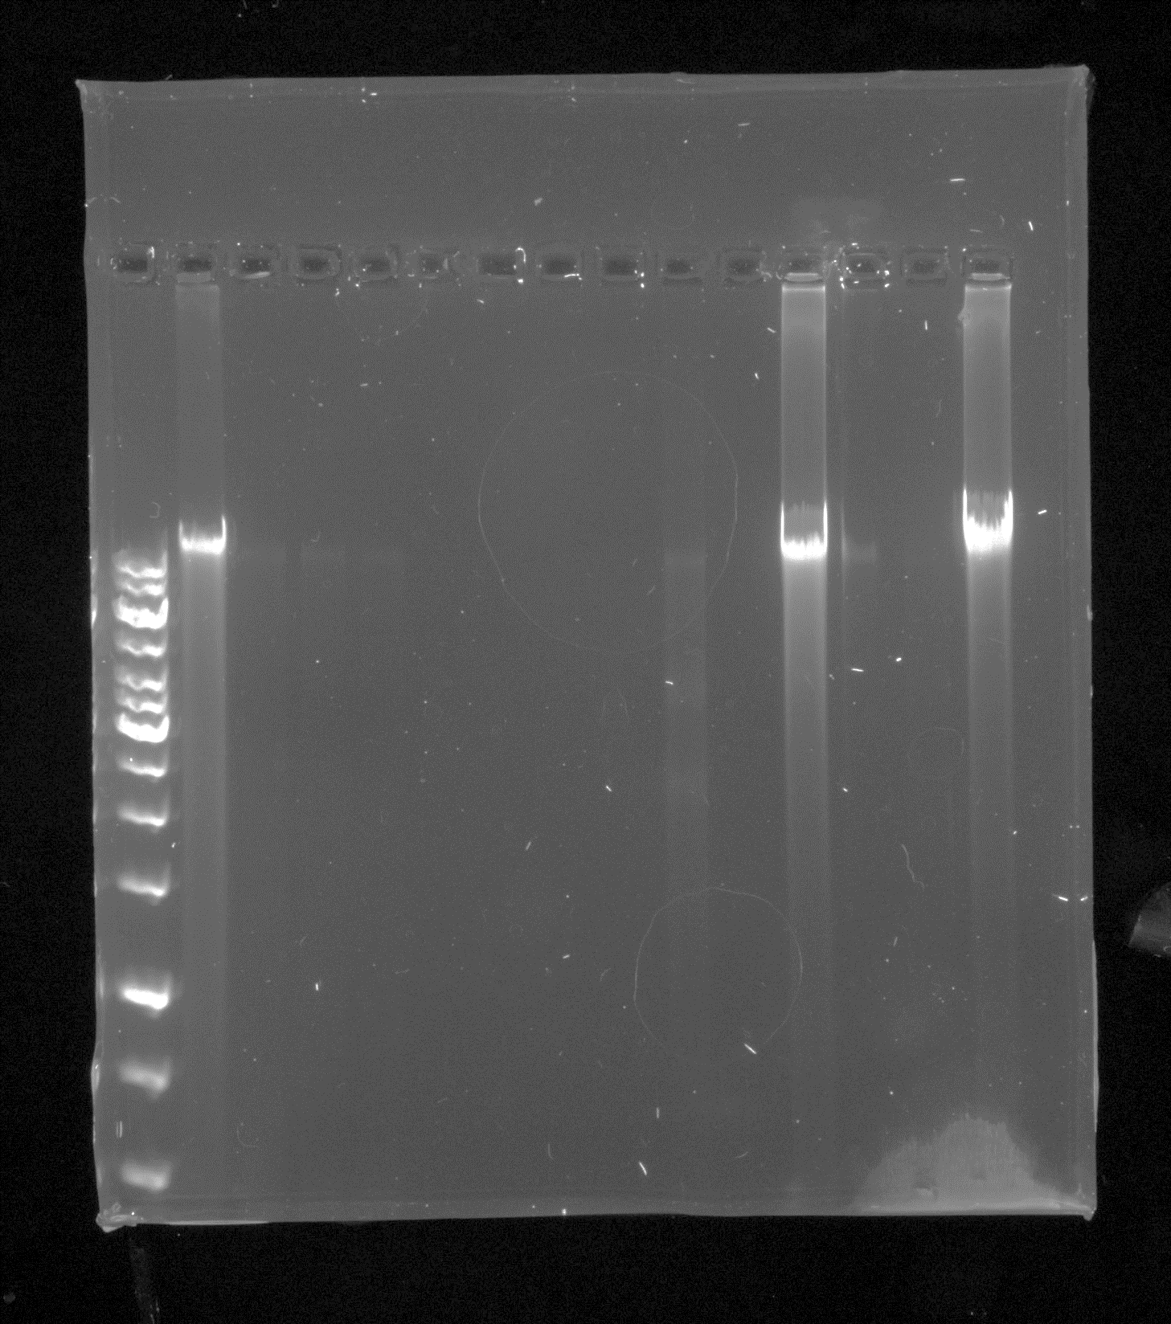
Gel 2

Slide 6
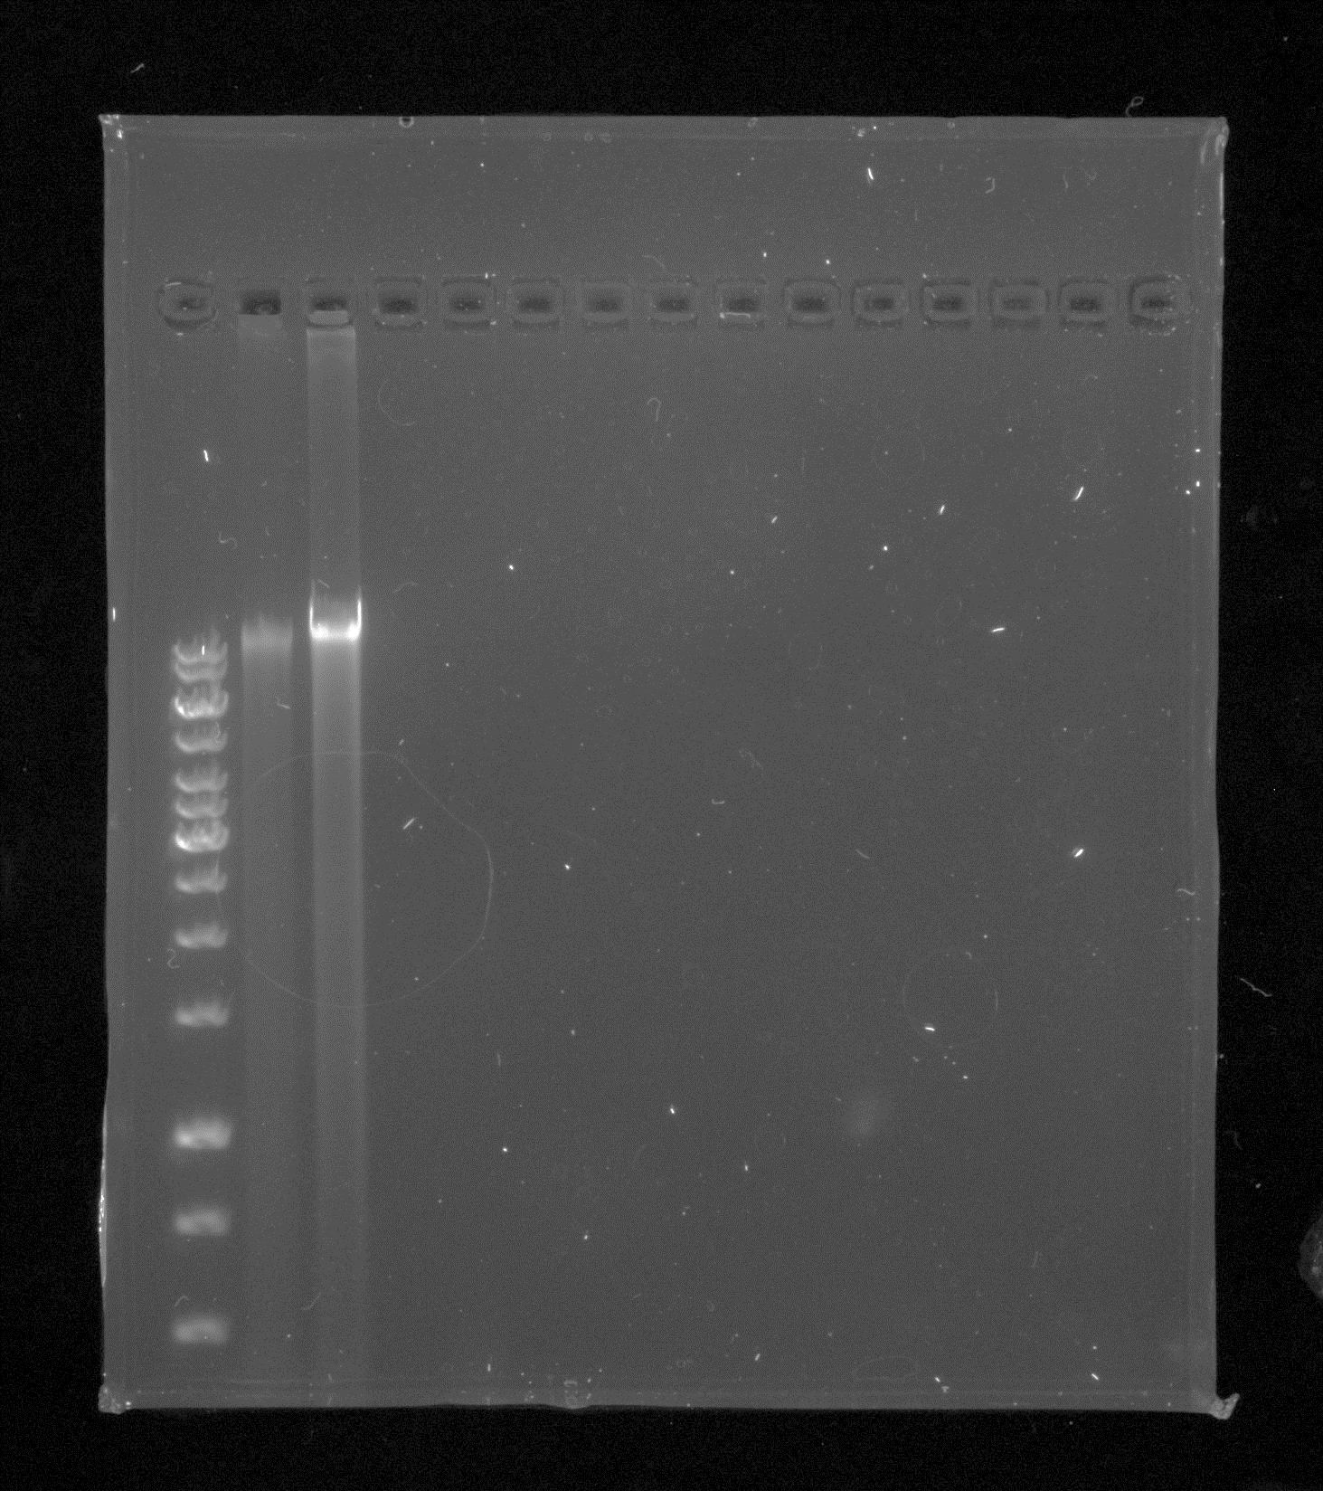
Gel 3

Slide 7
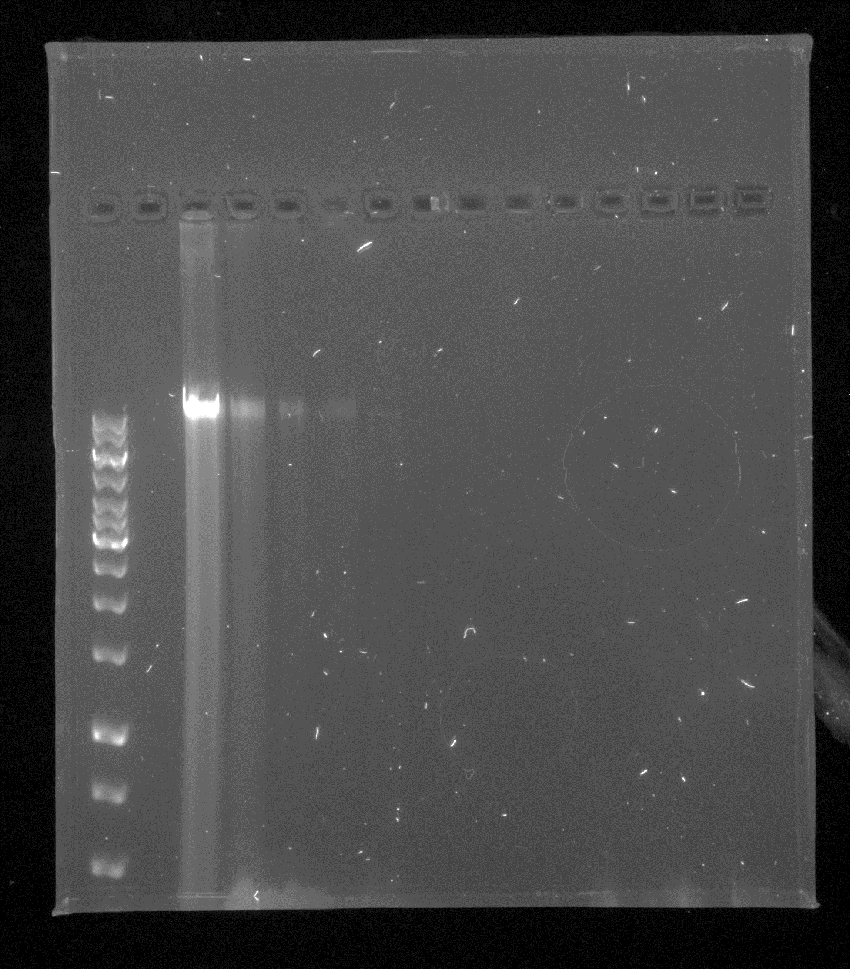
Gel 4

Slide 8
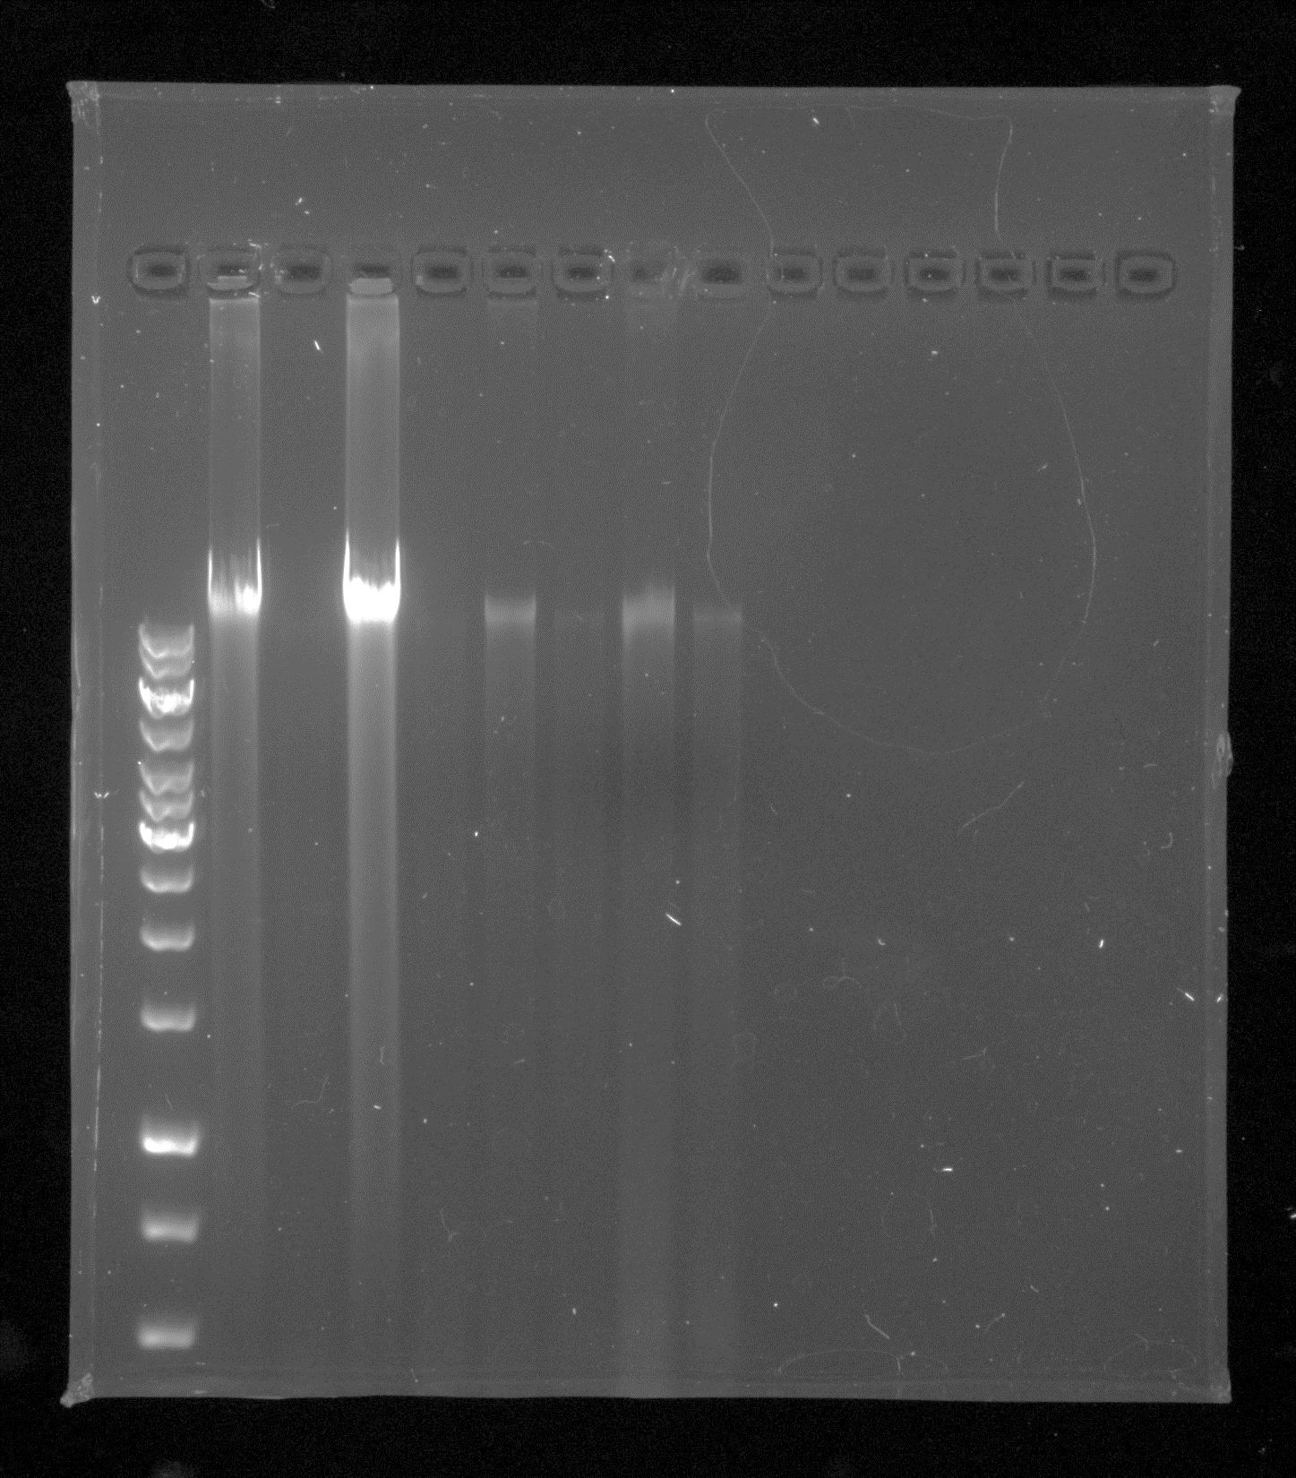
Gel 6

Slide 9
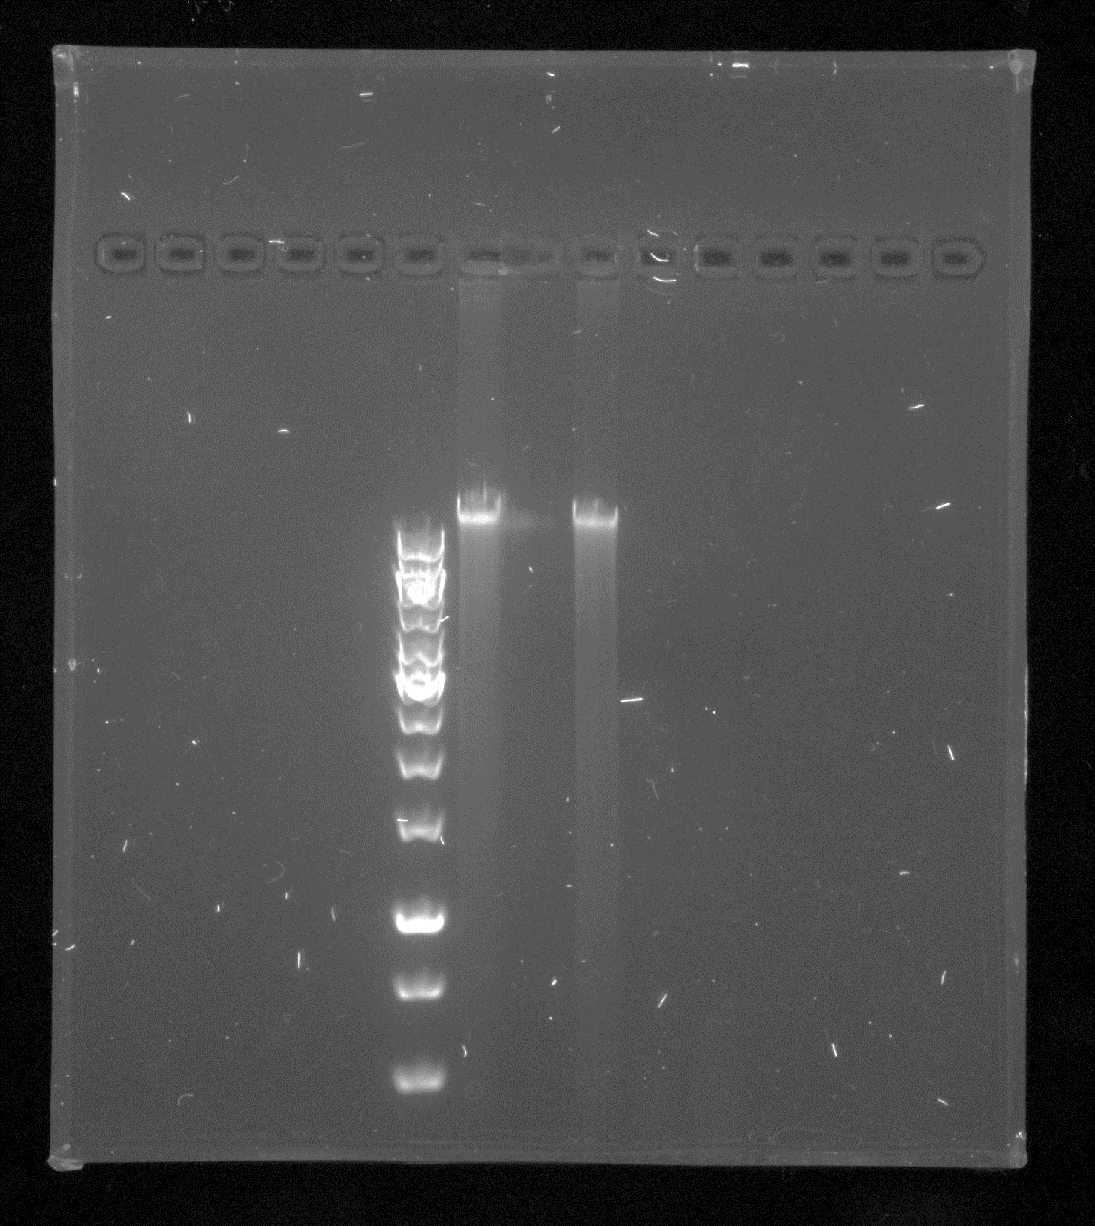
Gel 7

Slide 10
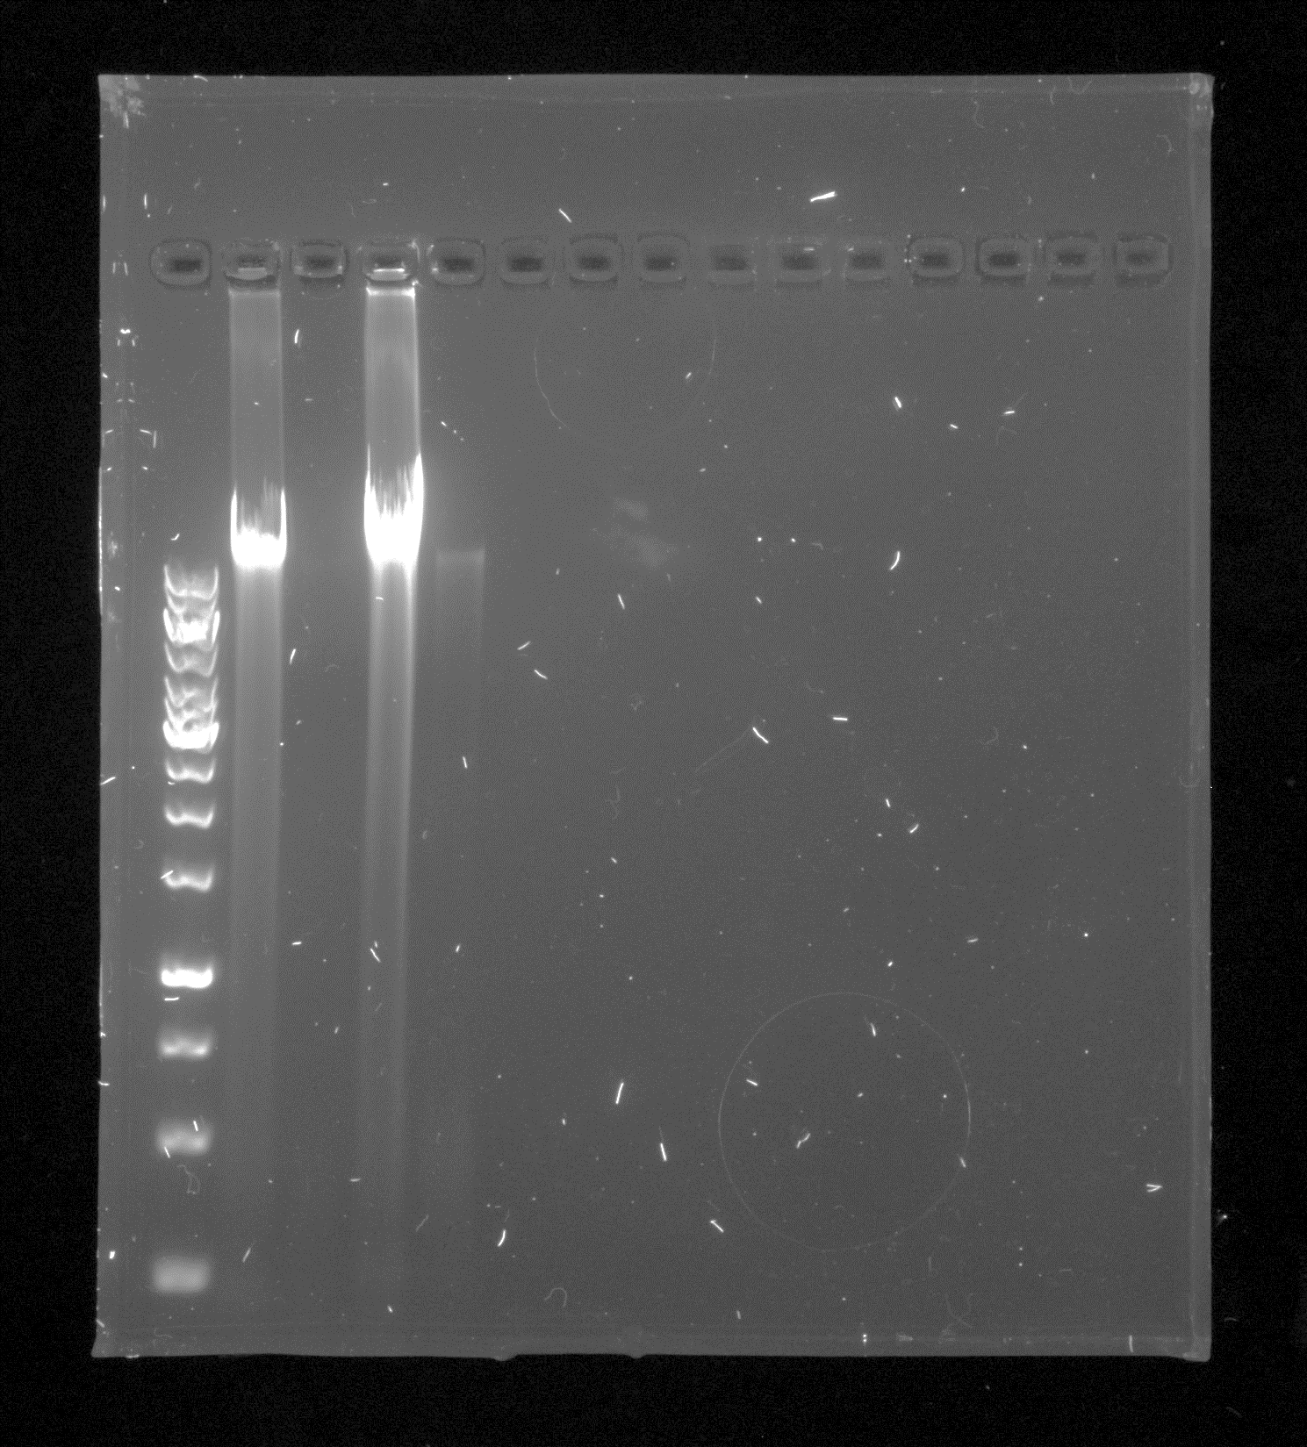
Gel 8

Slide 11
Anneleen
Ochrobactrum sp.
Rhizobium sp.
Sheared gDNA
bp
12000
6000
5000
4000

Slide 12
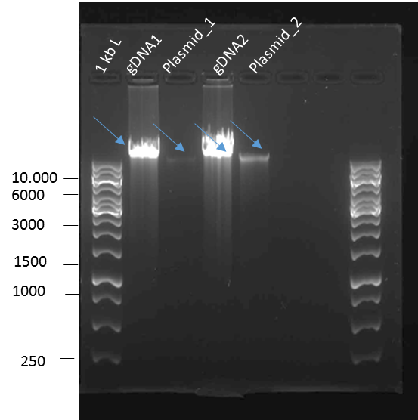
Gel results
Difficulties?
Can we estimate the chromosome size? What’s odd or not?
Do some of our strains have natural plasmids?
HOW TO
REPORT:
Figure 1: Agarose gel (1.5 %) of gDNA and plasmid DNA of Novosphingobium sp. ST904.
Order: 1kB ladder, gDNA1 = Novosphingobium gDNA, Plasmid_1=
Novosphingobium plasmid DNA, indicated with blue arrows.

Slide 13
Practicum outline
Yesterday
1. gDNA and plasmid extraction
2. Inspect the gel results
3. Perform a bacterial conjugation: let a donor bacterium exchange genetic material with your bacterium
4. Evaluate the outcome of genetic exchange by plasmid extraction, agarose gel and fluorescence microscopy
5. Inspect gel results, closing discussion of the practicum and more information about the written report
Today
Today
Monday
Tuesday

Slide 14
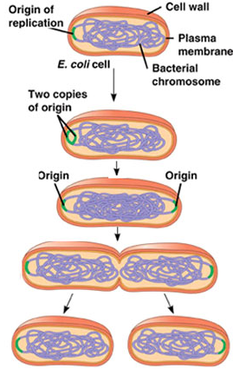
Most of the times bacteria reproduce by clonal reproduction
Mother cell
Bacteria reproduce by binary fission
Binary fission involves the copying of DNA and the splitting in 2 new cells
Vertical gene transfer
Daughter cell
Genetically identical

Slide 15
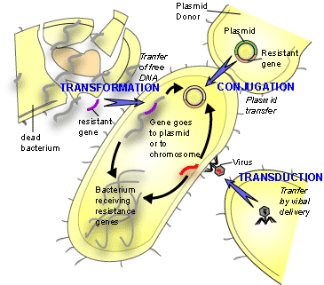
But! Bacteria can also exchange genetic information with neighbouring bacteria in their environment
How?
This lab

Slide 16
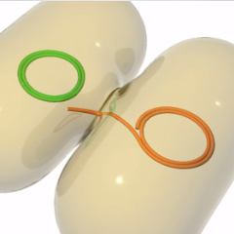
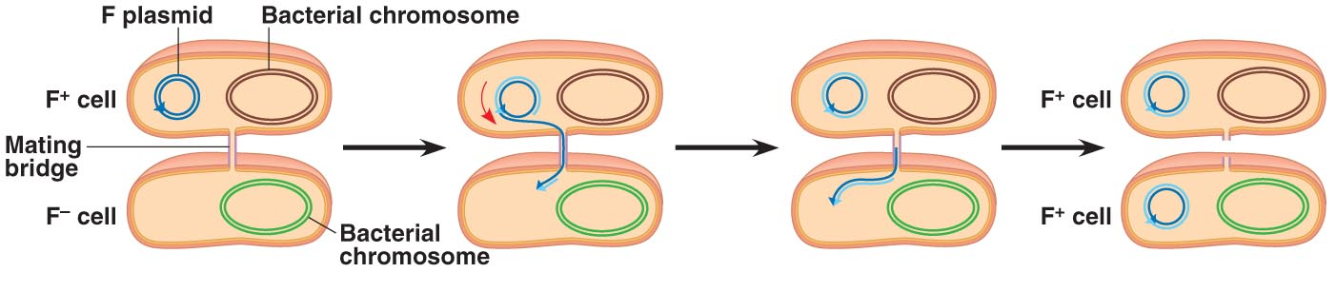
Conjugation
Transfer of DNA from one bacterium via sexual pilus and requires direct cell-to-cell contact
Conjugation and transfer of an F-plasmid

Slide 17
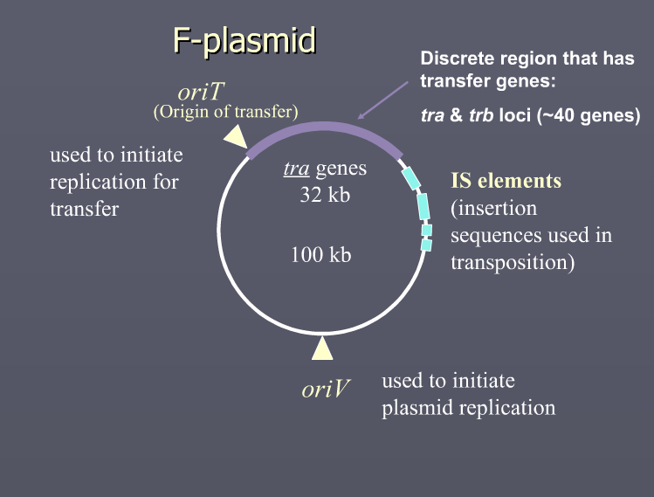
F-plasmid (conjugative plasmid)
Relaxase gene (TraI): enzyme creates a nick in one of the strands of the plasmid at oriT
Type 4 coupling protein (regulatory)
Type 4 secretion system: channel
Pilus genes
Takes about 5 min to transfer a vector of 100 kb

Slide 18
Triparental conjugation
The vector with GFP is transferred from E. coli donor to your recipient in triparental mating; antibiotic selection is used to obtain the desired transformant
Receptor bacterium
gfp
Km
Tc
E. coli donor pMP4655-gfp
E. coli helper pRK2013
Non-conjugative plasmid: incapable of initiating conjugation (lacks some essential genes) and needs help of a conjugative plasmid
Conjugative plasmid: carries all genes required for conjugation

Slide 19
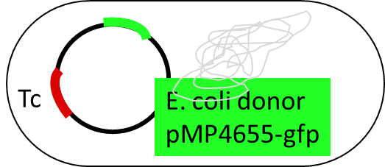
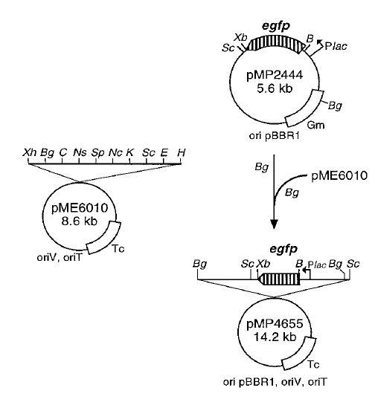
Vector of the donor
Broad-host range vector with enhanced green fluorescent protein (egfp)
Stable expressing vector
Very stable vector pMP4655
Non self-conj. Plasmid with gfp-gene

Slide 20

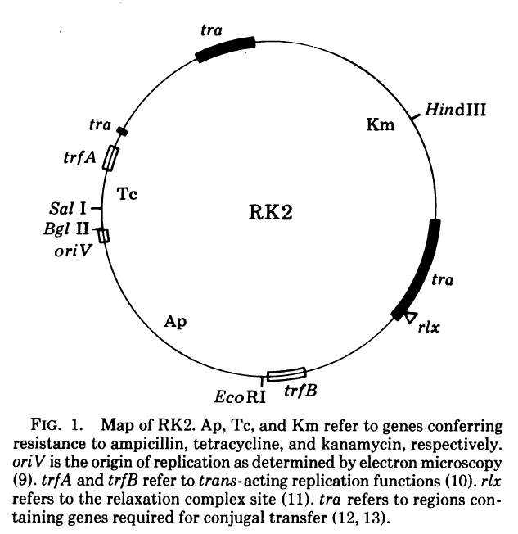
Vector of the helper

Slide 21
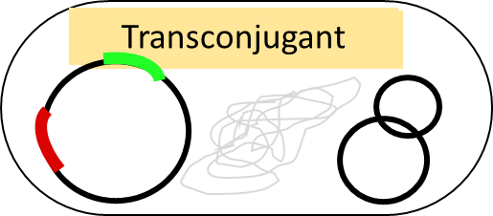
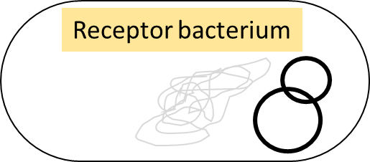
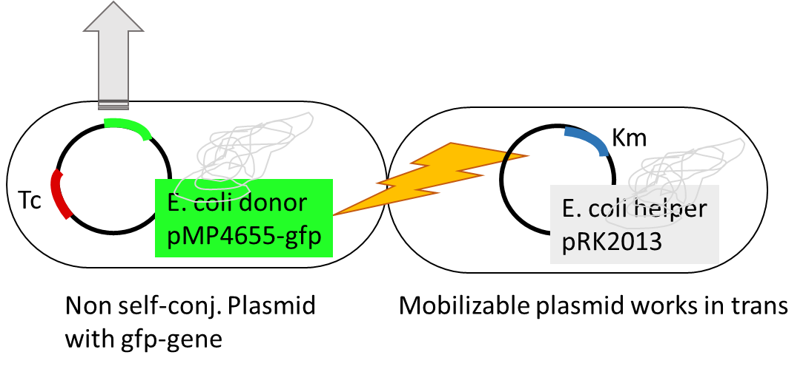
Receptor bacterium
Vector of the donor (gfp) is transferred in trans with the conjugative vector of the helper to the recipient

Slide 22
Triparental conjugation
How to select your transconjugant?
Petri plate
Receptor bacterium

Slide 23


Triparental conjugation
Selective medium?
Medium composition?
Growth T?
Petri plate
Receptor bacterium

Slide 24
Triparental conjugation
Selective medium?
Medium composition?
Growth T?
Petri plate
Receptor bacterium

Slide 25
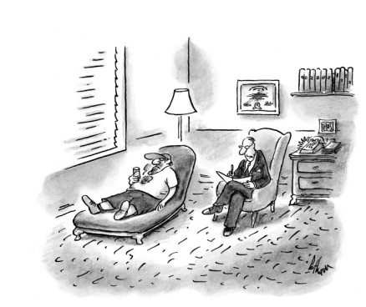
Triparental conjugation
Growth of the transconjugant over the weekend
Petri plate
Receptor bacterium

Slide 26
Practicum outline
Yesterday
1. gDNA and plasmid extraction
2. Inspect the gel results
3. Perform a bacterial conjugation: let a donor bacterium exchange genetic material with your bacterium
4. Evaluate the outcome of genetic exchange by plasmid extraction, agarose gel and fluorescence microscopy
5. Inspect gel results, closing discussion of the practicum and more information about the written report
Today
Today
Monday
Tuesday

Slide 27
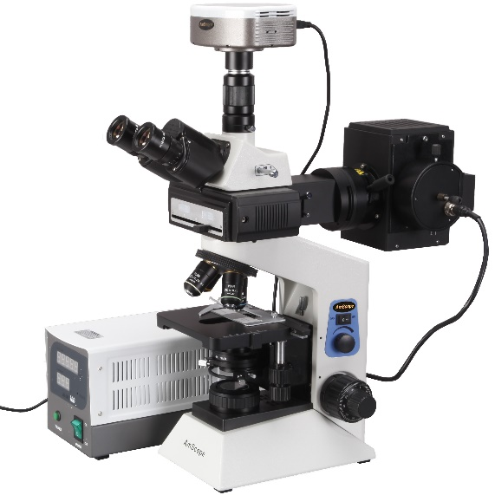
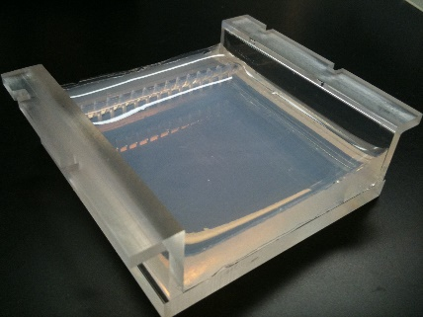
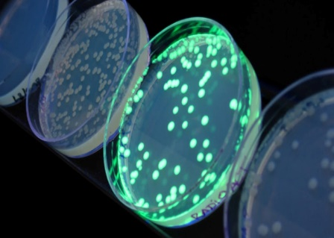
Evaluate results of conjugation
Fluorescence microscopy
Petri plate
Check on the gel,
Plasmid DNA-extraction
Receptor bacterium

Slide 28

Objective: You understand how bacteria exchange genetic information in the environment, how this relates to changes in the genomic architecture of bacteria and their behaviour, characteristics
Before
After

Slide 29
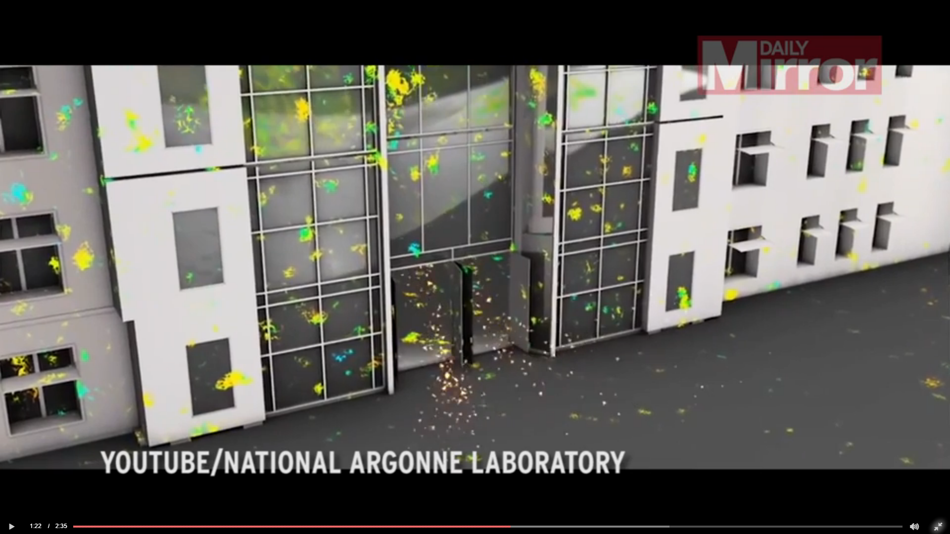

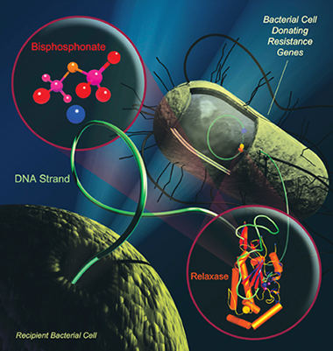
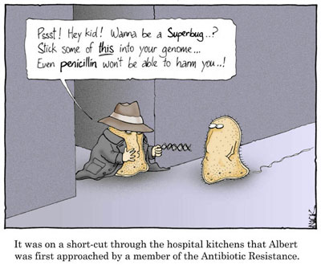
Implications of horizontal gene transfer between bacteria and mutations

Slide 30
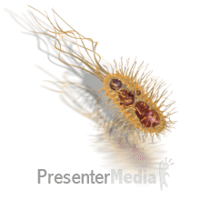


The bacterial genome and genetic variation by conjugation
Today
3. Perform a bacterial conjugation
Let’s start!
Work sterilely
Desinfect work bench
Desinfect hands
Disposal of all tips/bacteria in waste beakers!

Slide 31
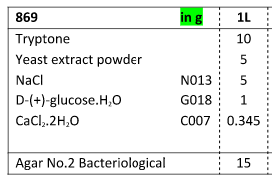
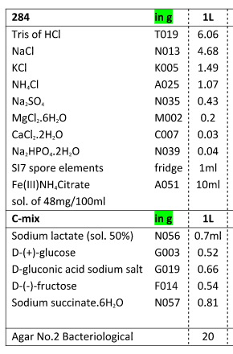
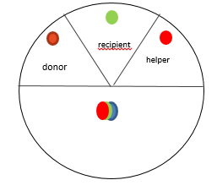
Composition of 869 rich and mineral salts medium
Medium used to let conjugation happen
Medium used after conjugation
869
Why did we use a rich 869 medium here?
Why do we use the selective 284 medium after conjugation?
- tip: does E. coli grows on 284 medium?
+ other components to create
selective pressure: look up properties of your
receptor strain

